Slide 1
MATLAB FOR ROBOT VISION

Slide 2
MATLAB FOR VISION

Slide 3
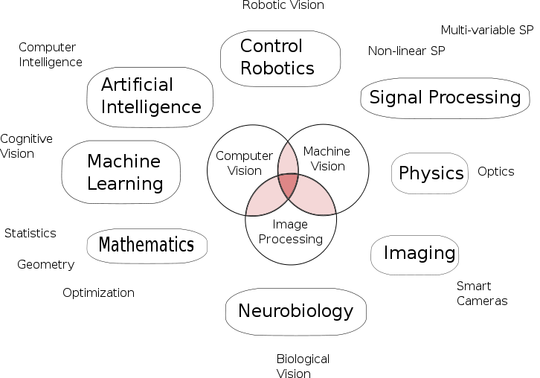
Vision is multidisciplinary
Computer Graphics
HCI
From wiki

Slide 4
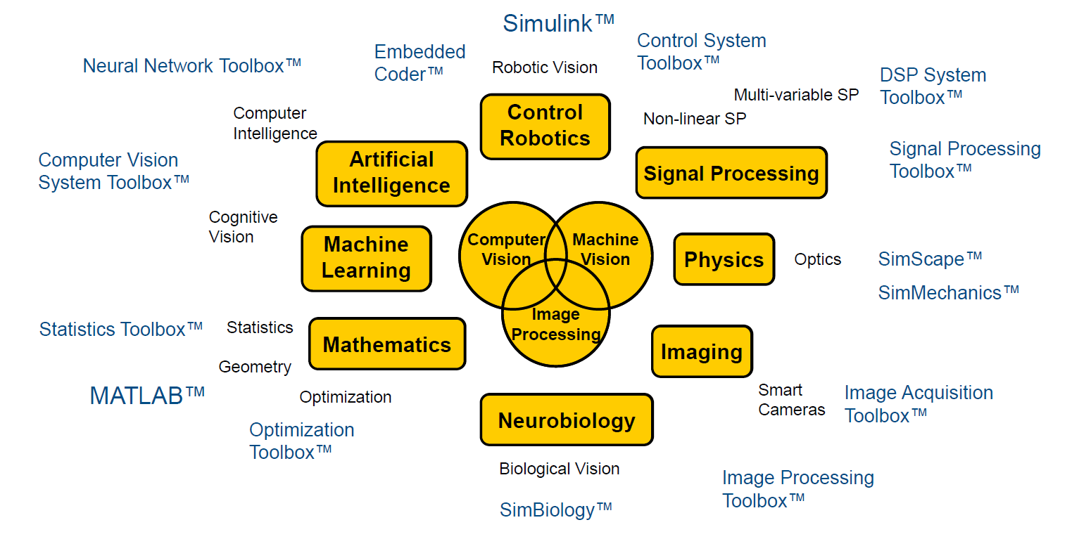
SOFTWARE TOOLS FOR VISION

Slide 5
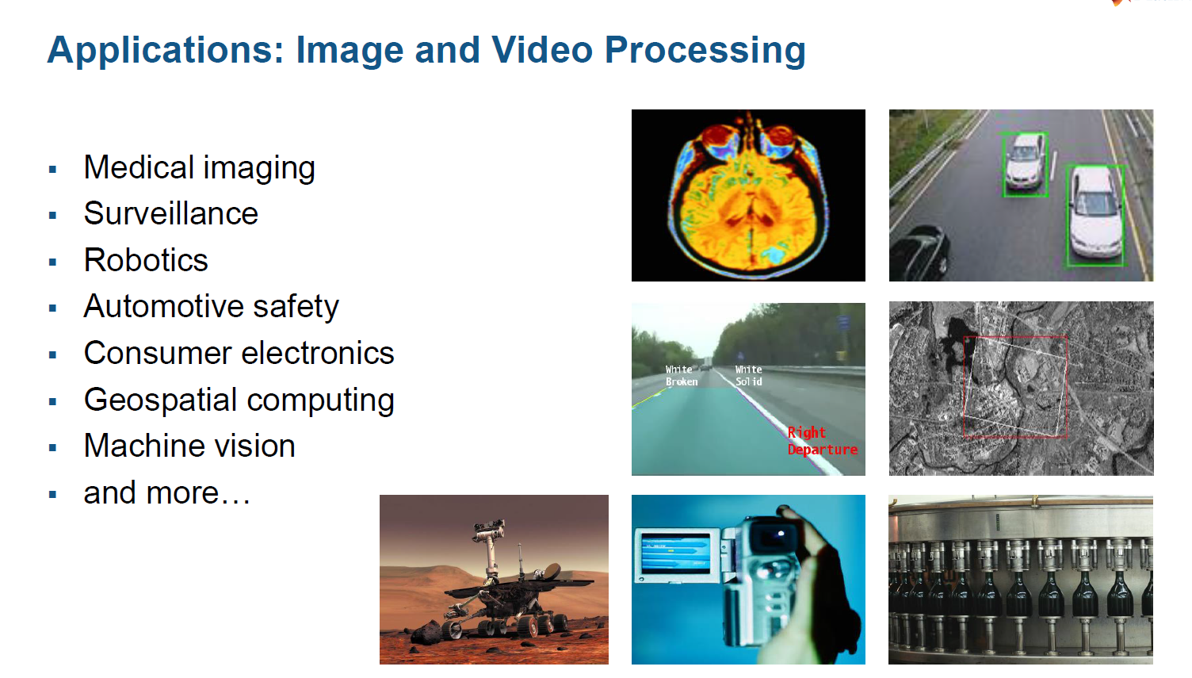

Slide 6
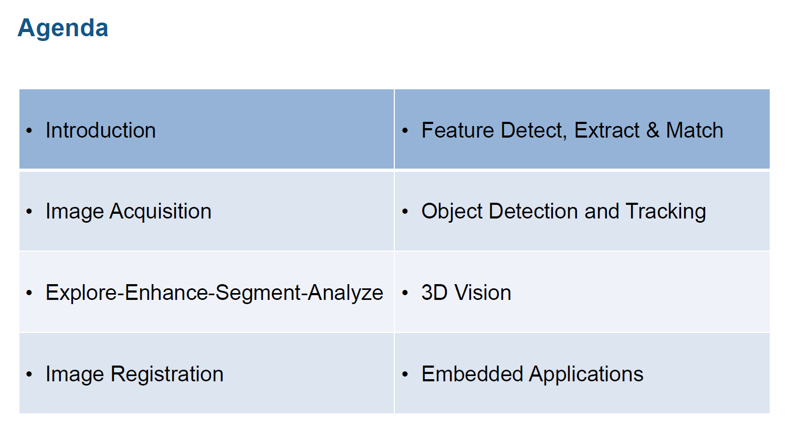

Slide 7
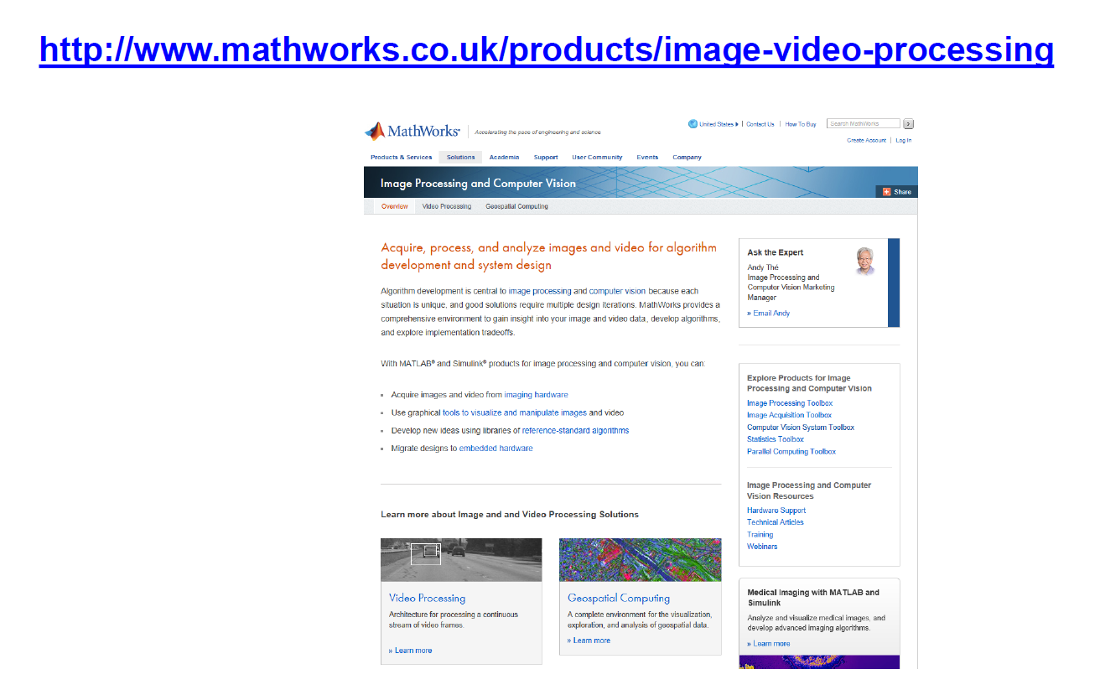

Slide 8
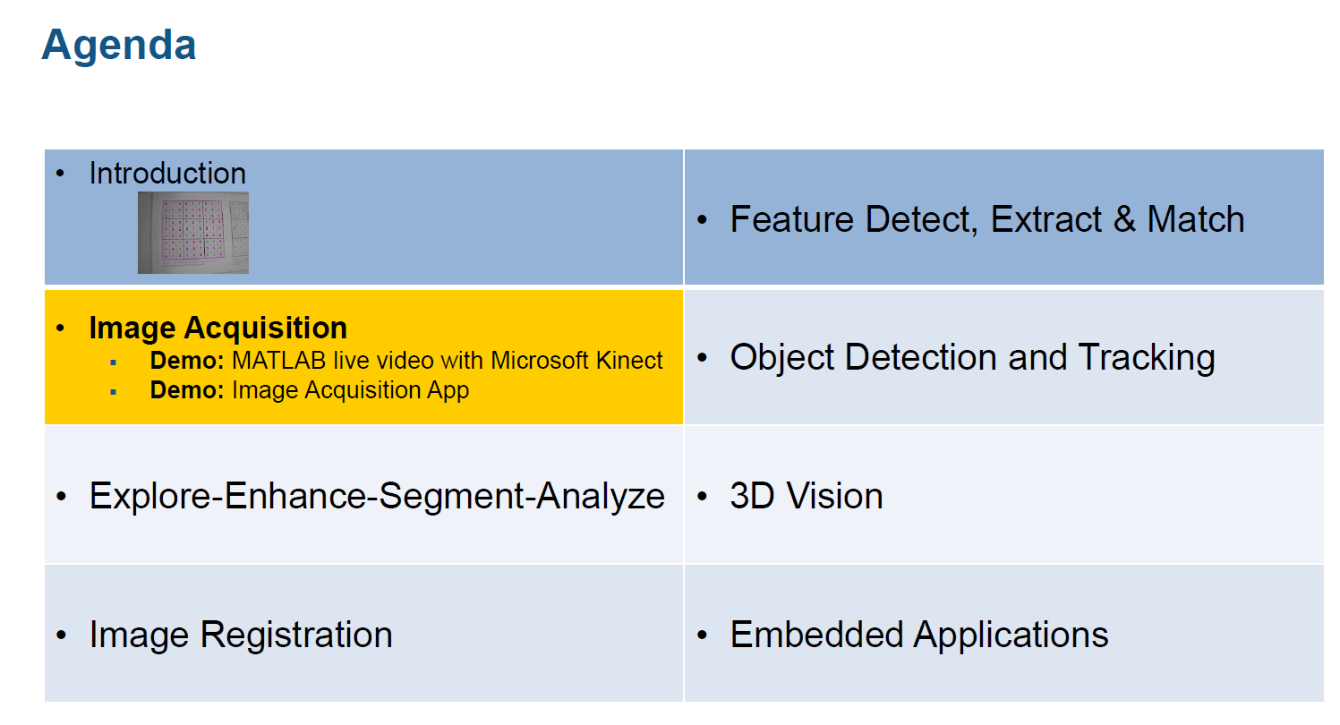

Slide 9
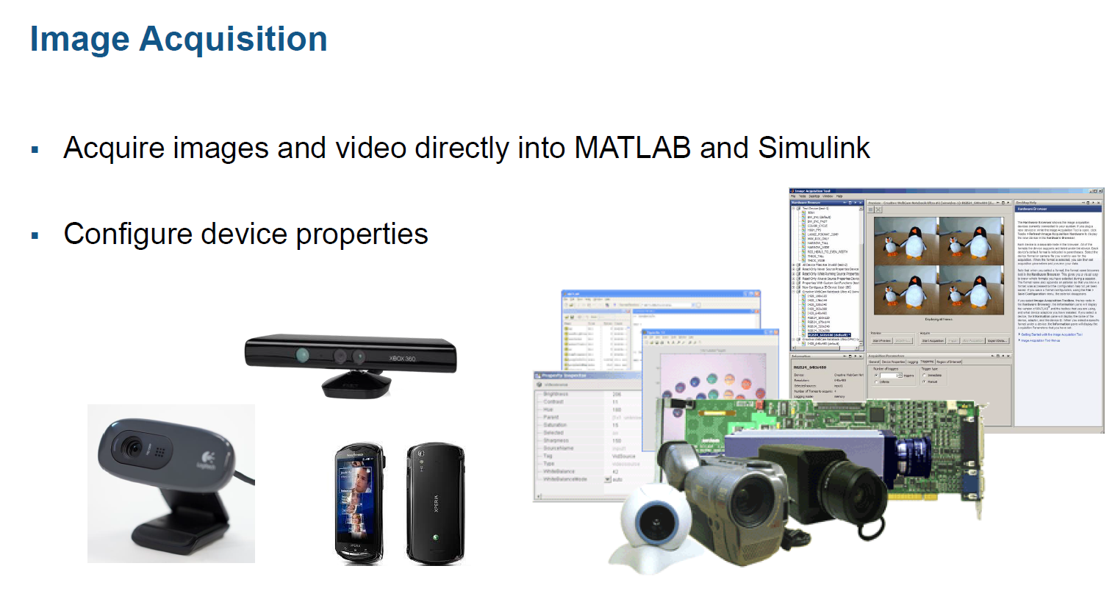

Slide 10
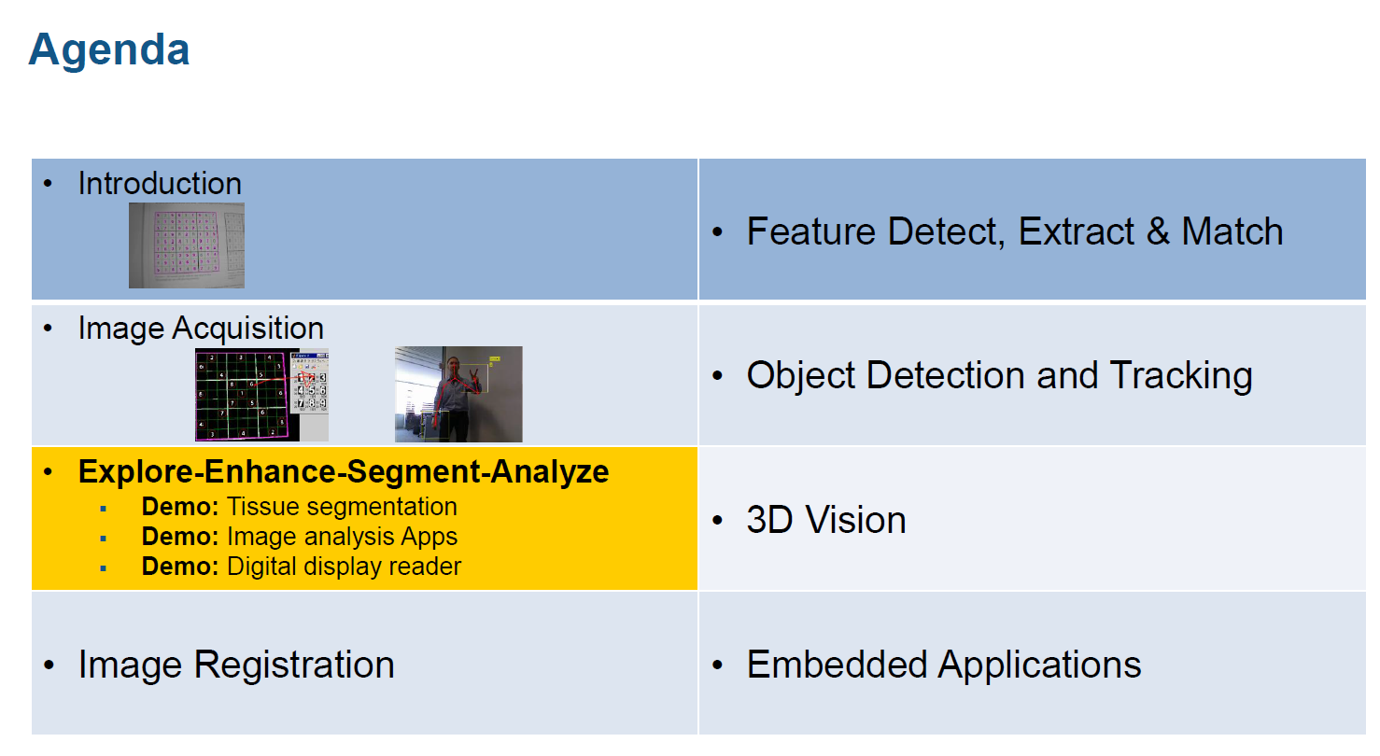

Slide 11
SEGMENTATION

Slide 12
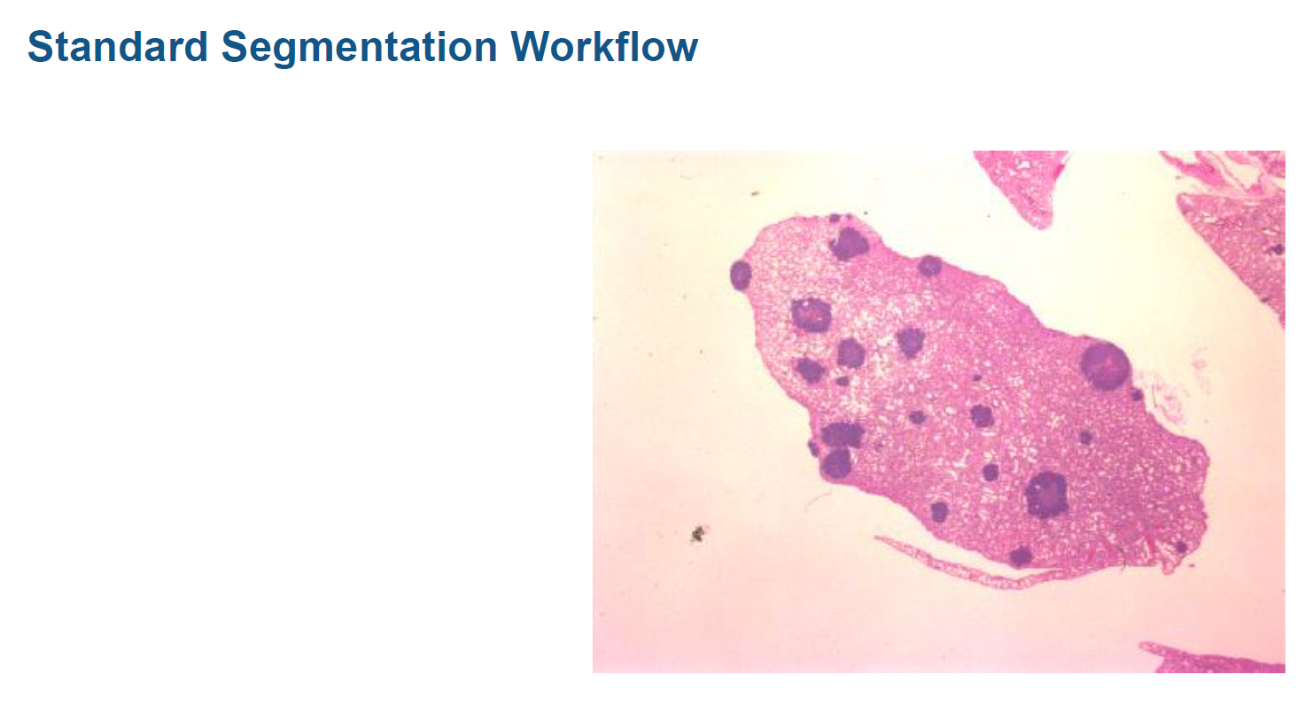

Slide 13
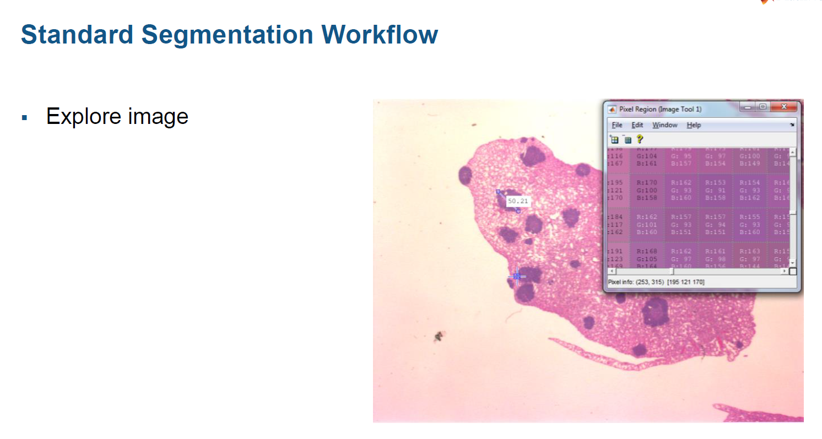

Slide 14
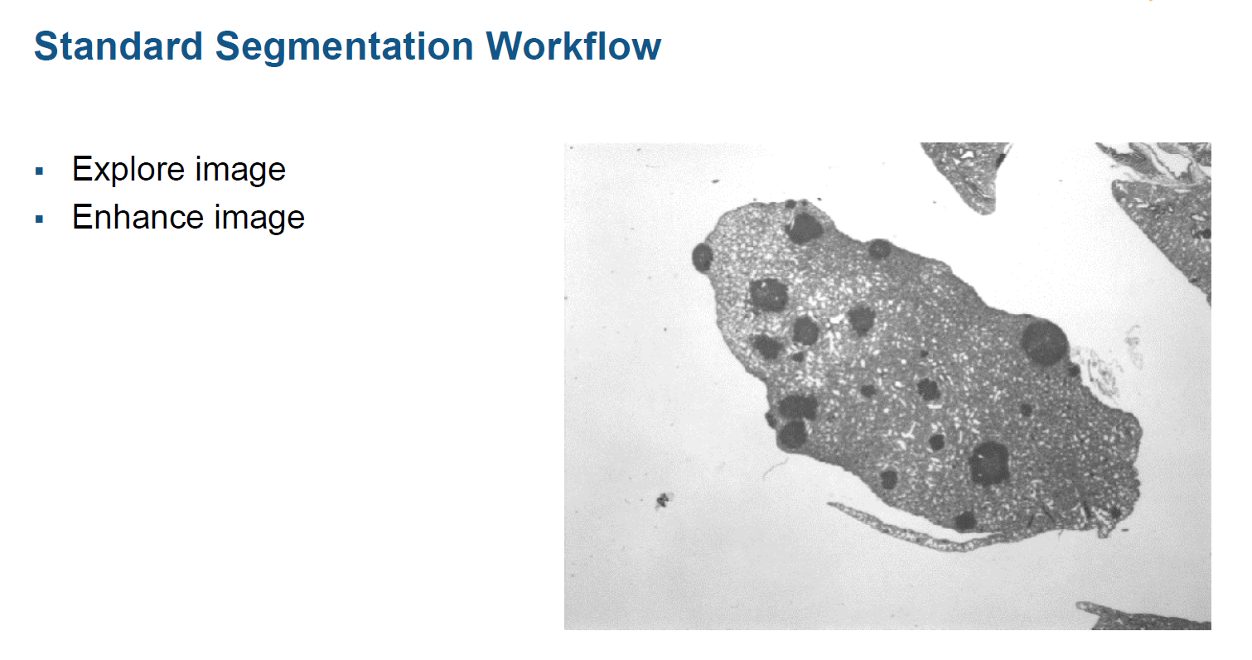

Slide 15
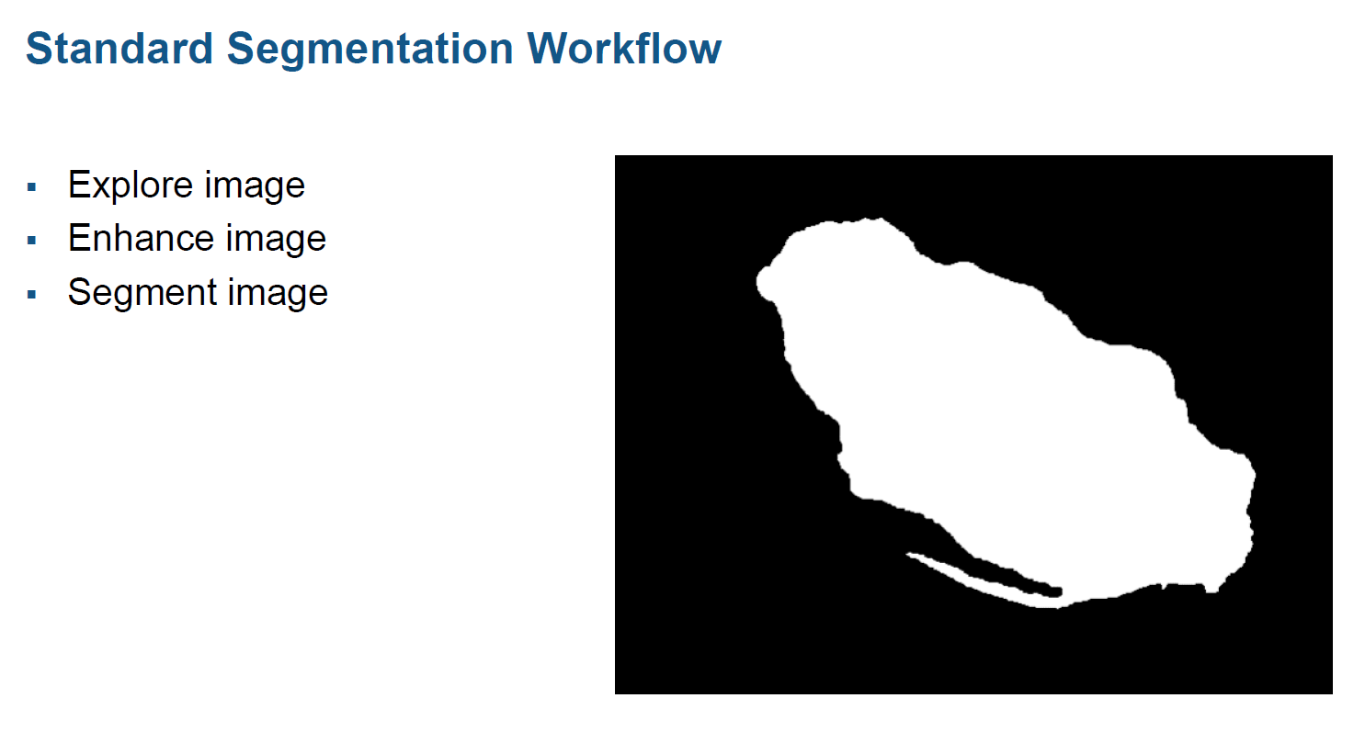

Slide 16
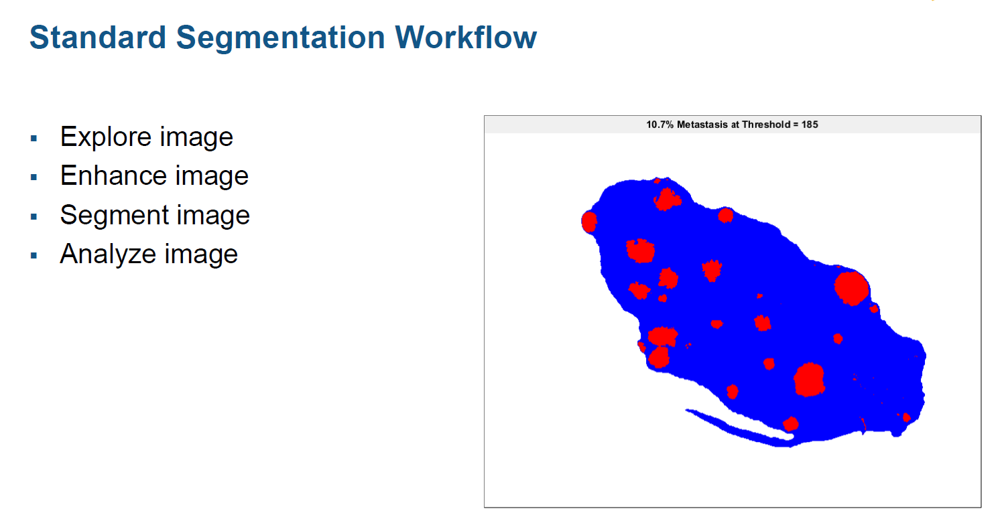

Slide 17
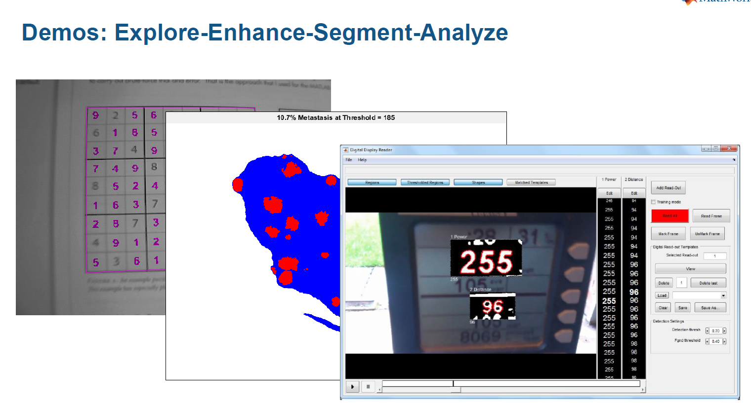

Slide 18
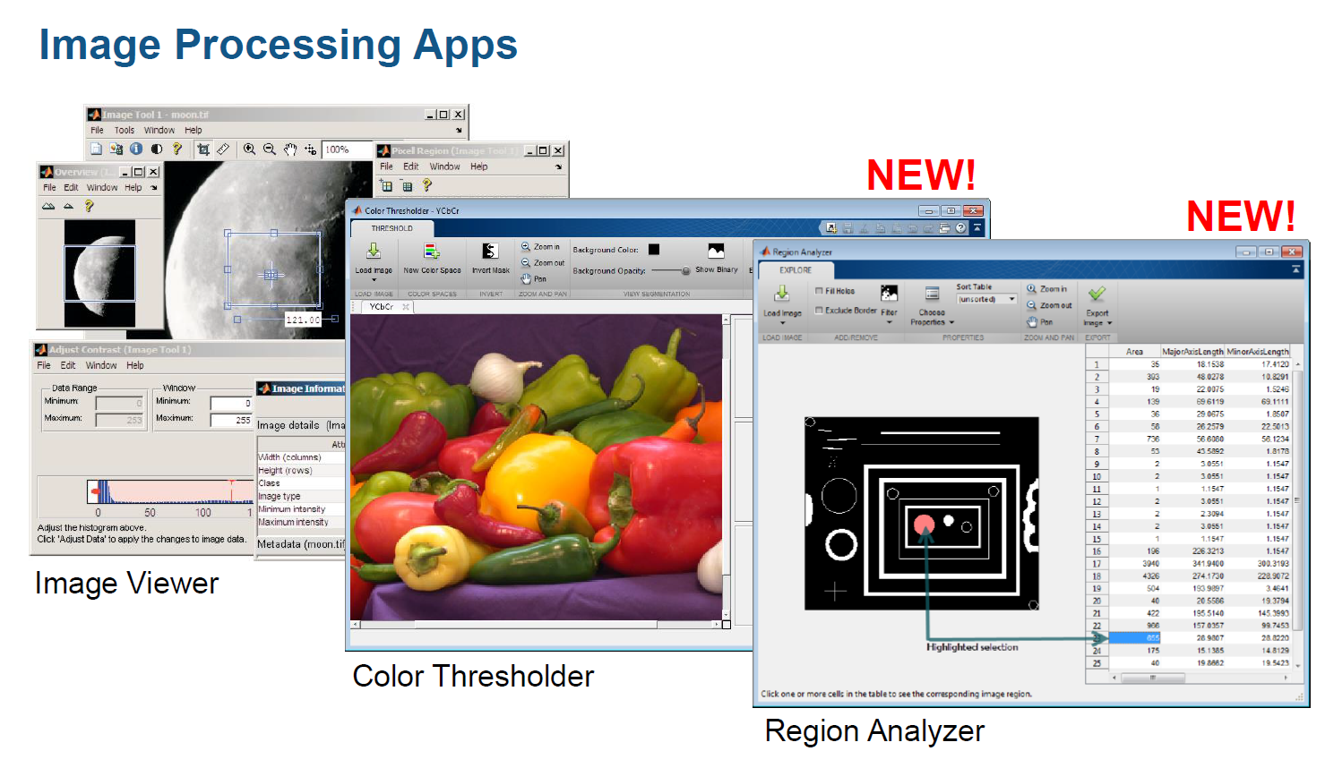

Slide 19
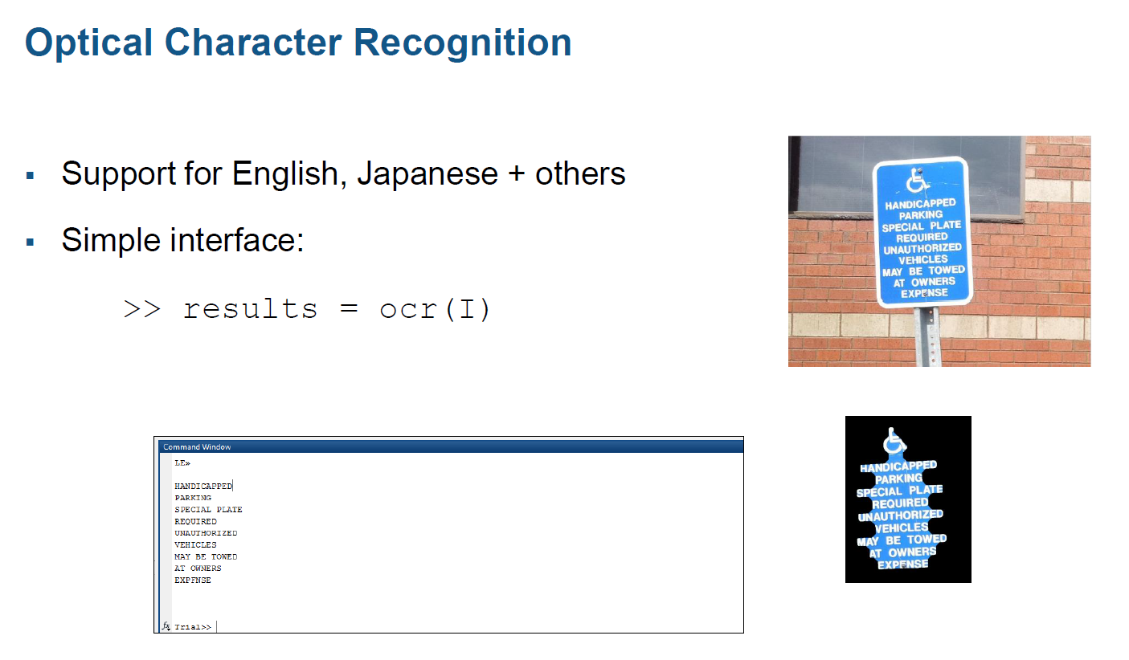
ocr

Slide 20
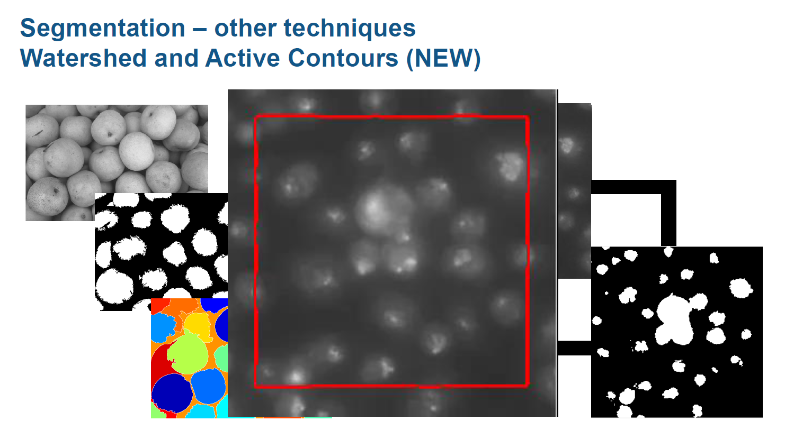

Slide 21
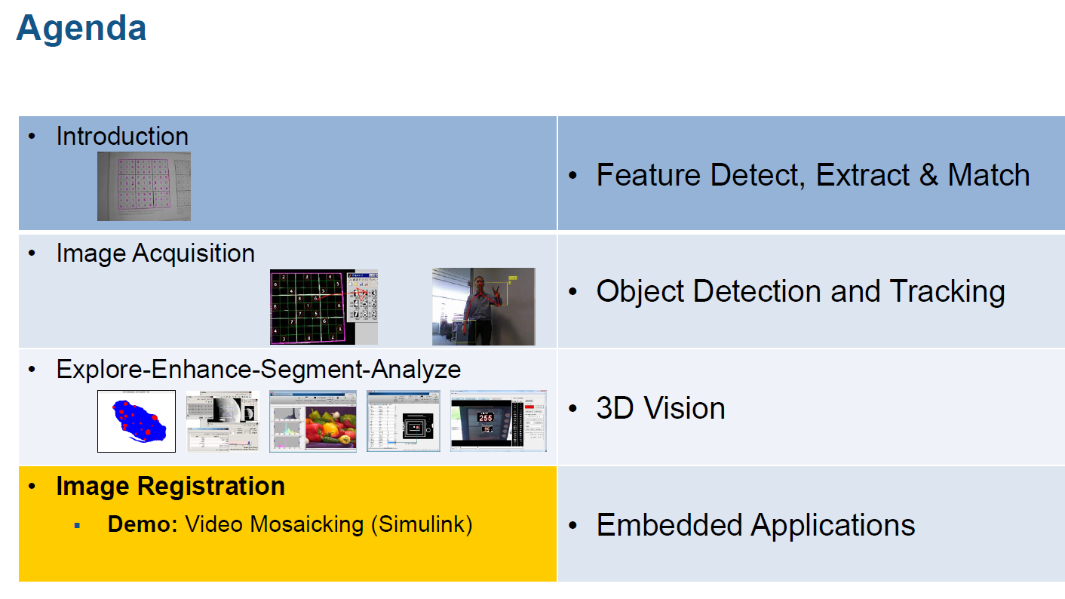

Slide 22
IMAGE REGISTRATION

Slide 23
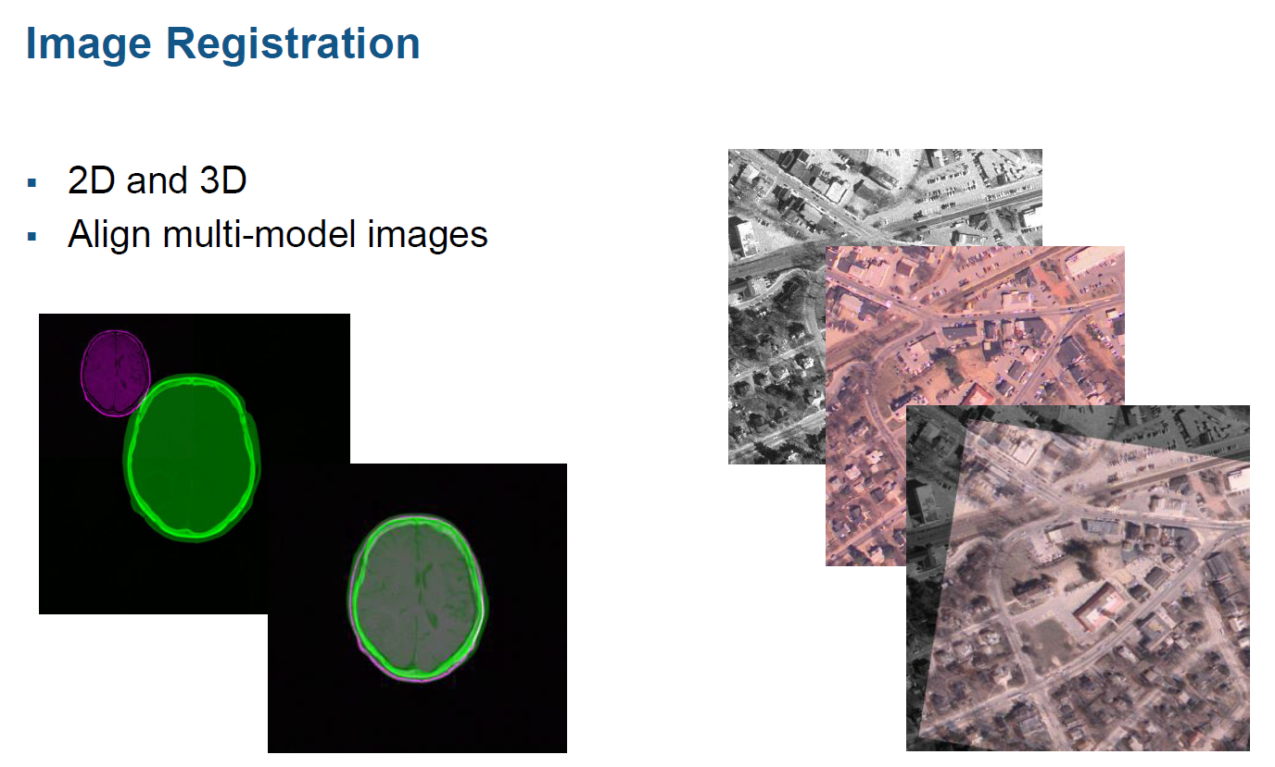

Slide 24
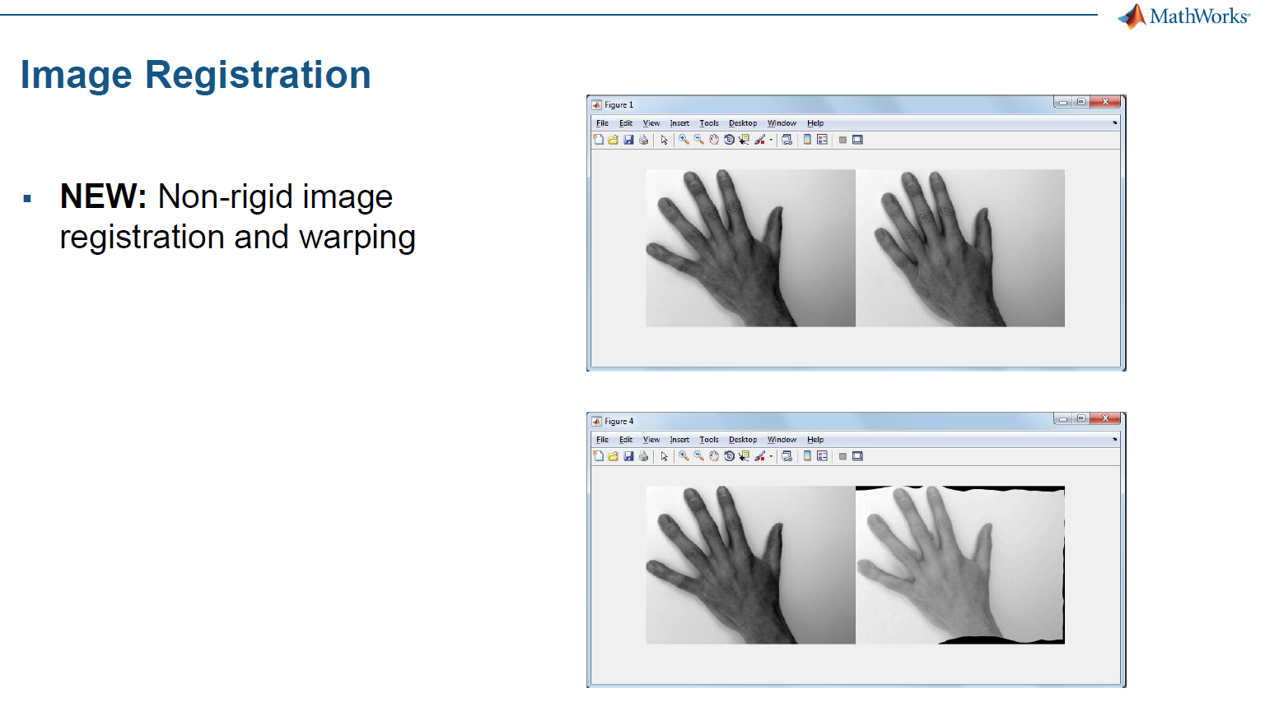

Slide 25
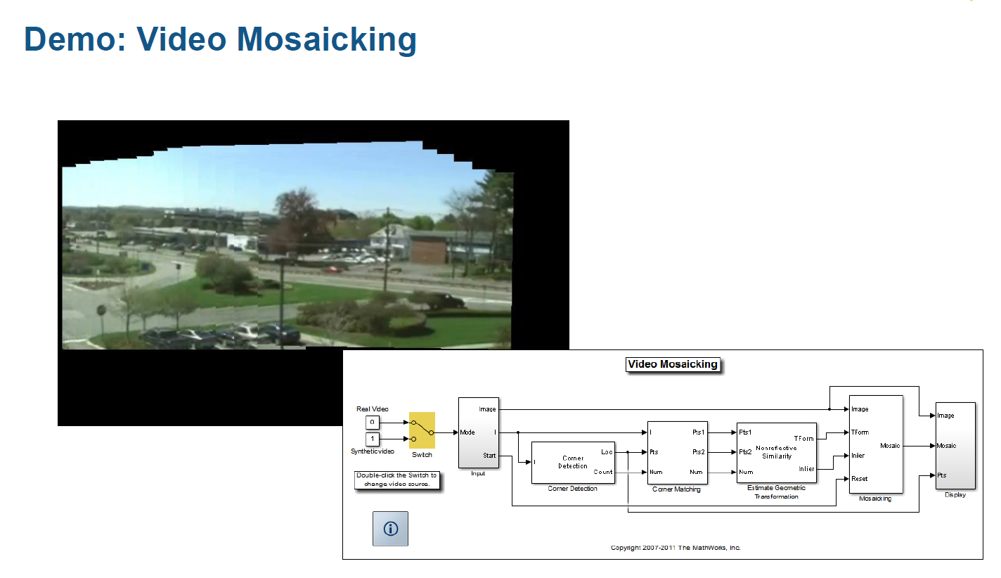

Slide 26
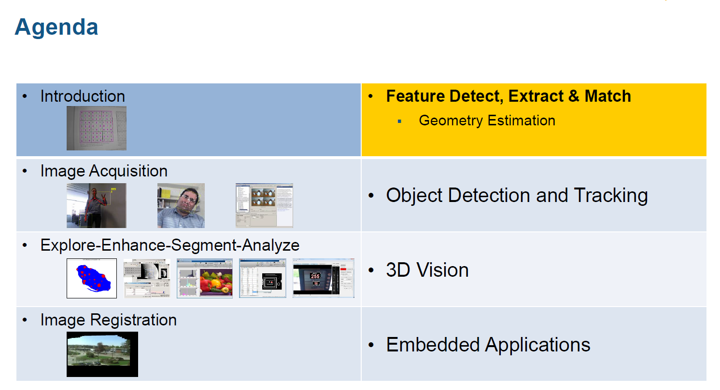

Slide 27
FEATURE DETECTION

Slide 28
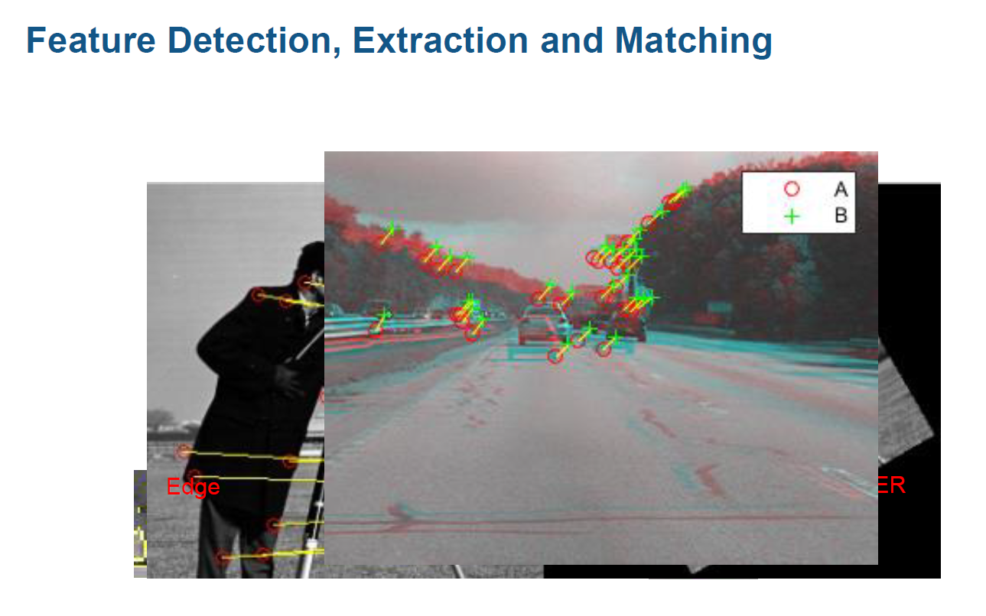

Slide 29
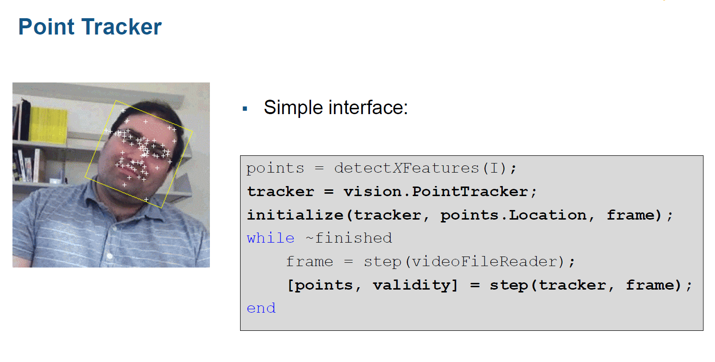
step

Slide 30
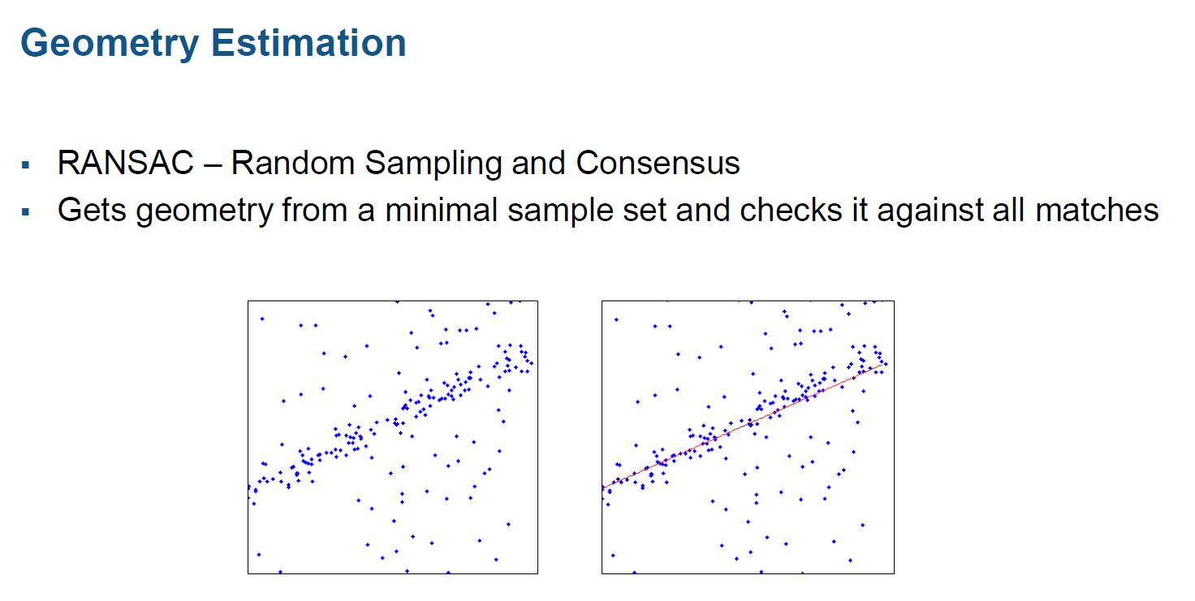

Slide 31
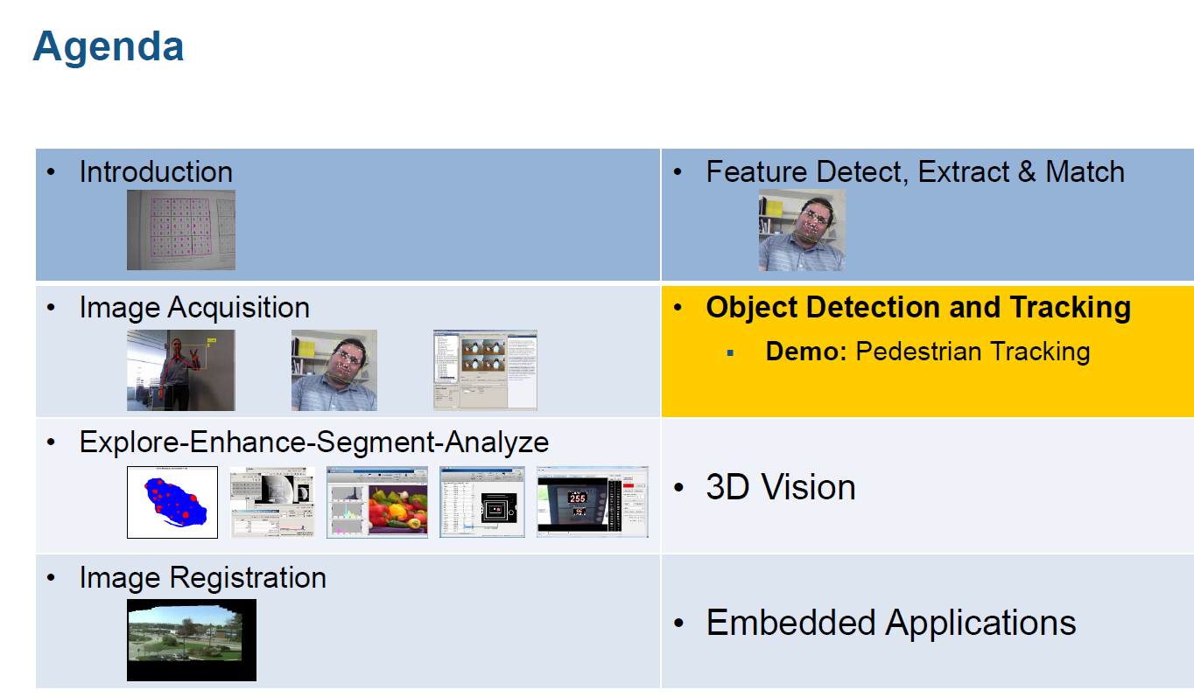

Slide 32
OBJECT DETECTION AND TRACKING

Slide 33
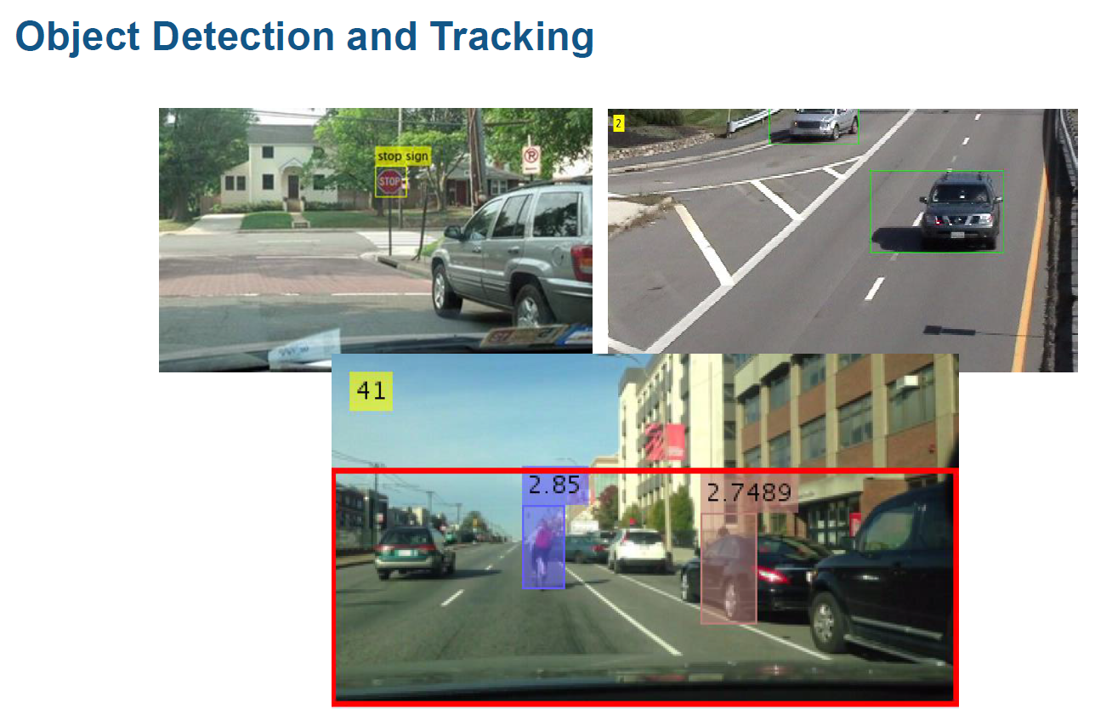

Slide 34
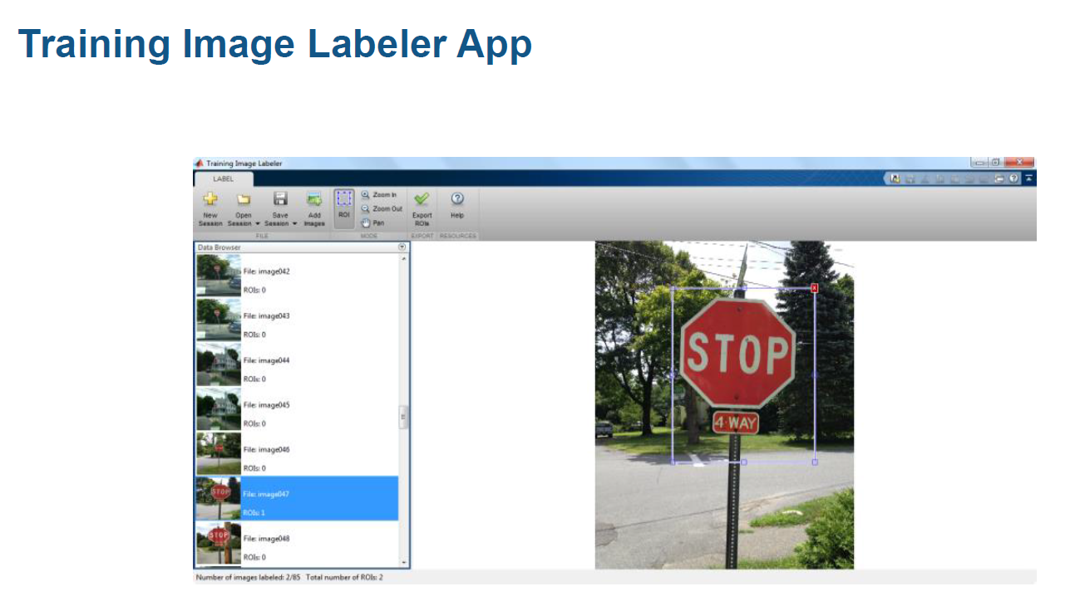

Slide 35
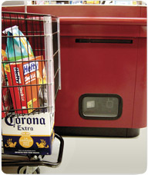
Object recognition (in supermarkets)
LaneHawk by EvolutionRobotics
“A smart camera is flush-mounted in the checkout lane, continuously watching for items.
When an item is detected and recognized, the cashier verifies the quantity of items that were found under the basket, and continues to close the transaction.
The item can remain under the basket, and with LaneHawk, you are assured to get paid for it… “

Slide 36
Face Detection, Face Recognition, People Detection and Foreground Detection

Slide 37
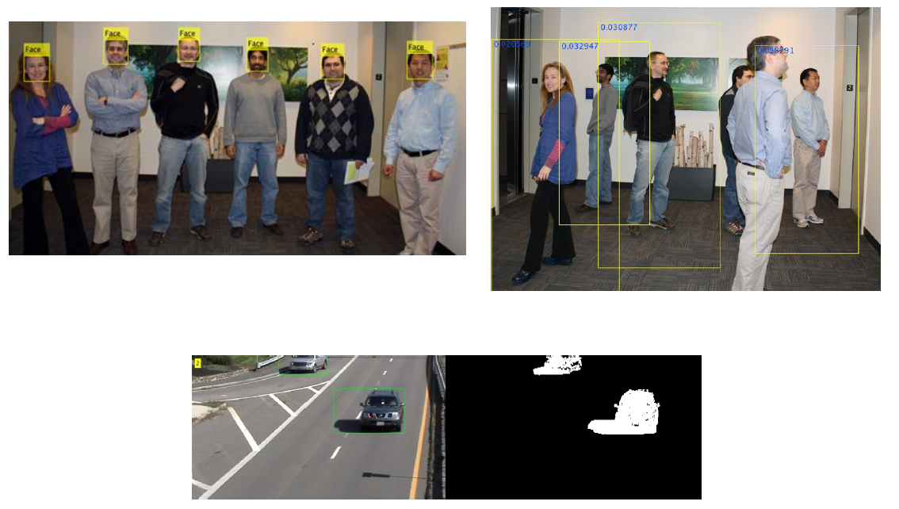
Face Detection, Face Recognition, People Detection and Foreground Detection

Slide 38
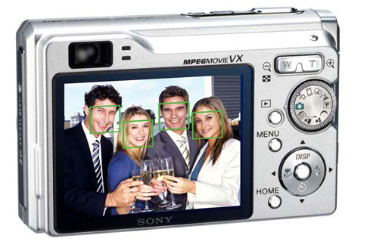
Face detection
Many new digital cameras now detect faces
  Canon, Sony, Fuji, …
Notes:
Why would this be useful? Main reason is focus. Also enables “smart” cropping.

Slide 39
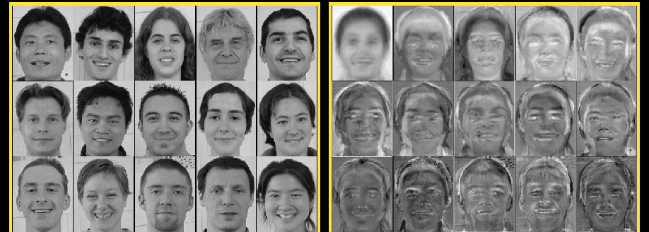
Face Recognition
Principle Components Analysis (PCA)
Face Recognition

Slide 40
Smile detection
Sony Cyber-shot® T70 Digital Still Camera

Slide 41
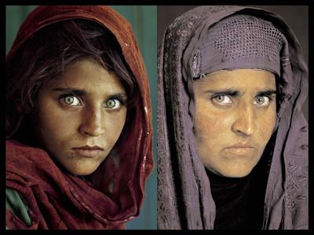
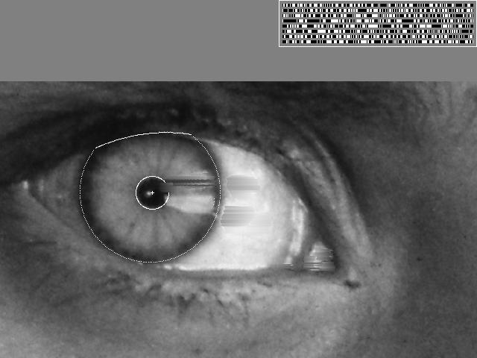
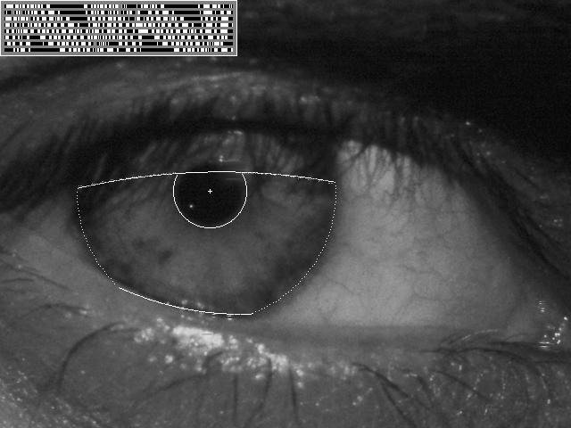
Vision-based biometrics
“How the Afghan Girl was Identified by Her Iris Patterns” Read the story
wikipedia
Notes:
Age 12, Age 30,
The mathematical odds against such an event are 6 million to one for her right eye

Slide 42
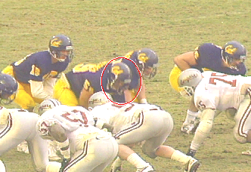
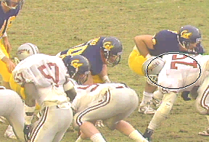
Tracking

Slide 43
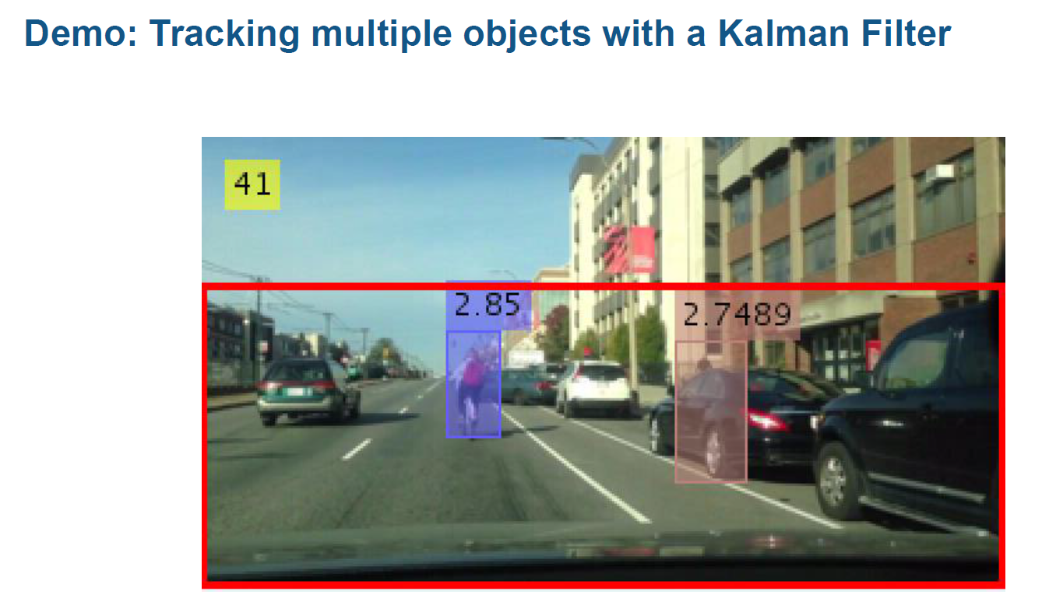

Slide 44
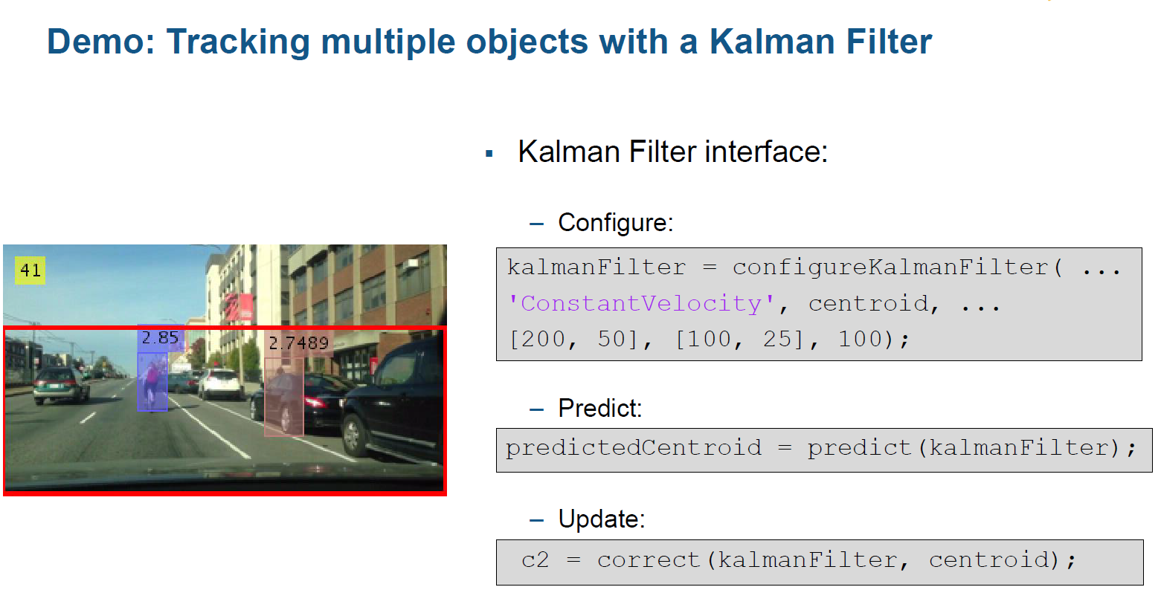

Slide 45
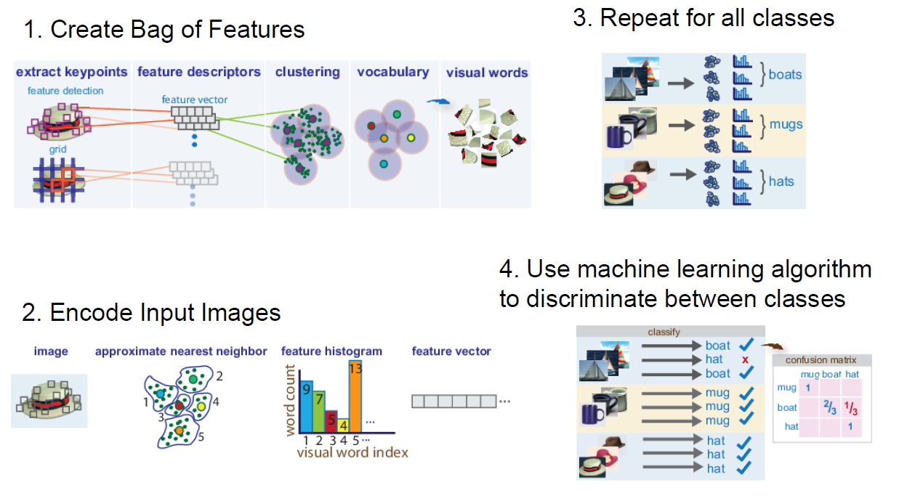
Bag of words for Category Classification

Slide 46
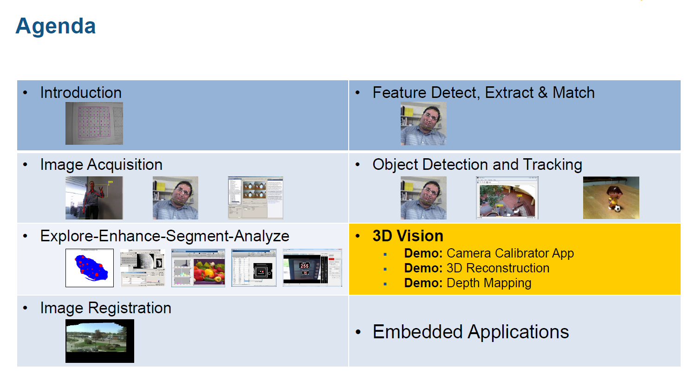

Slide 47
3D VISION

Slide 48
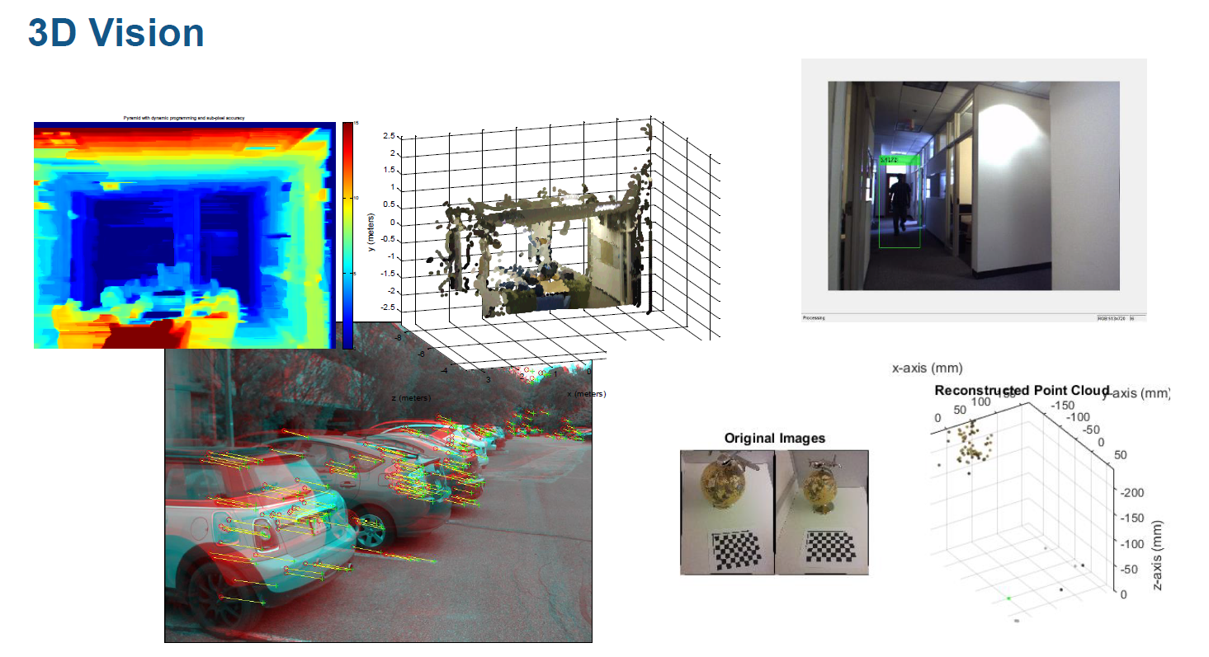

Slide 49
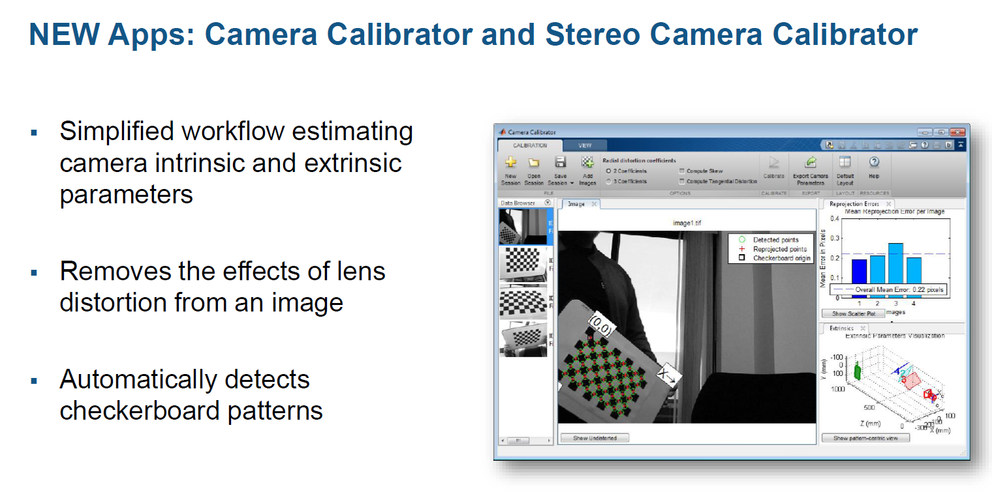

Slide 50
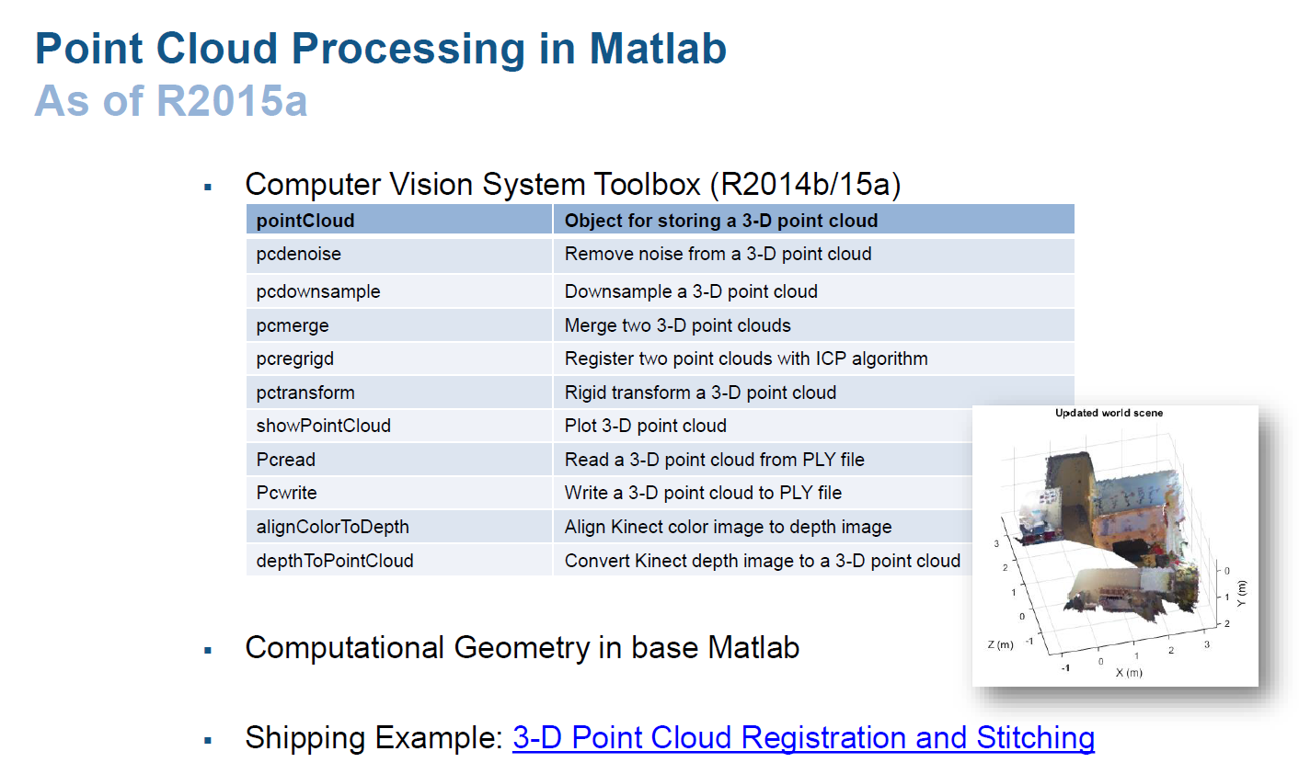

Slide 51
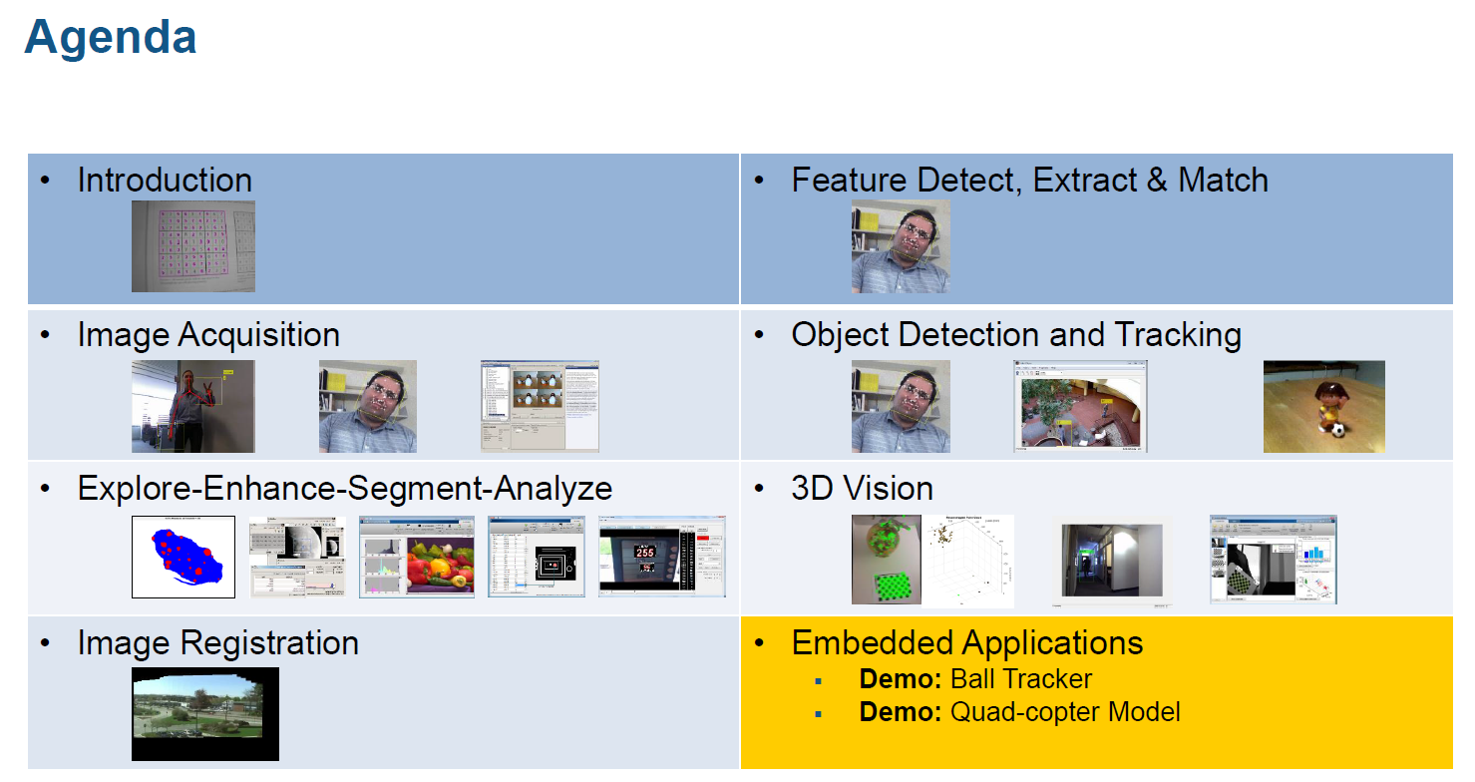

Slide 52
EMBEDDED APPLICATIONS

Slide 53
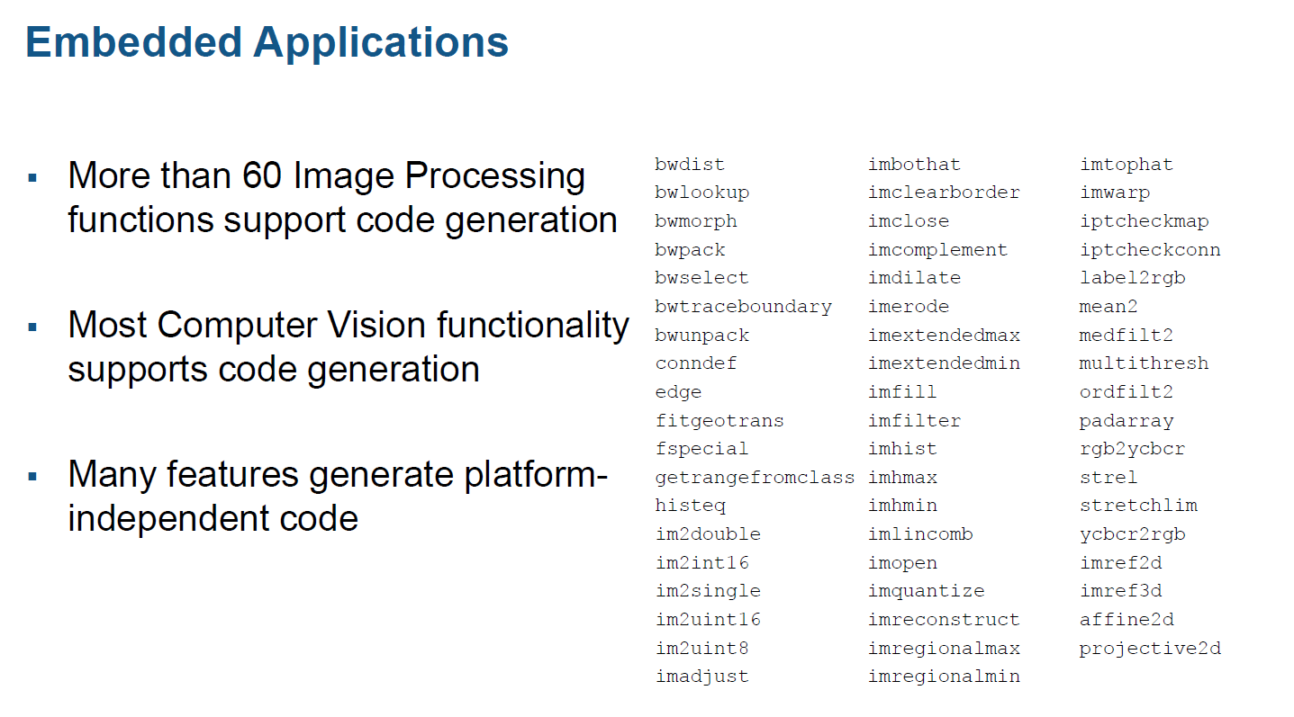

Slide 54
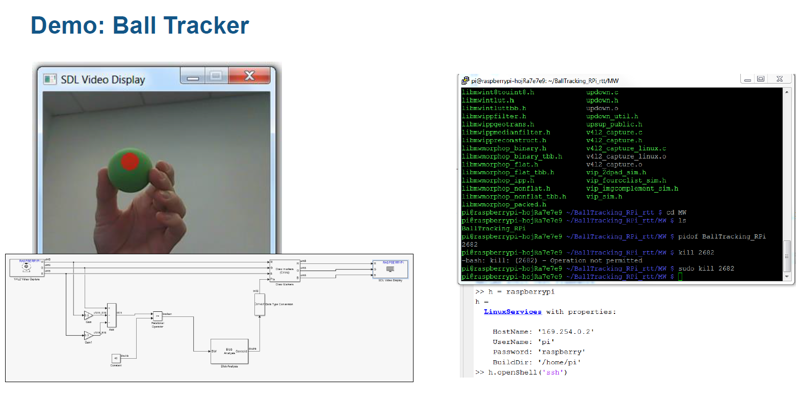

Slide 55
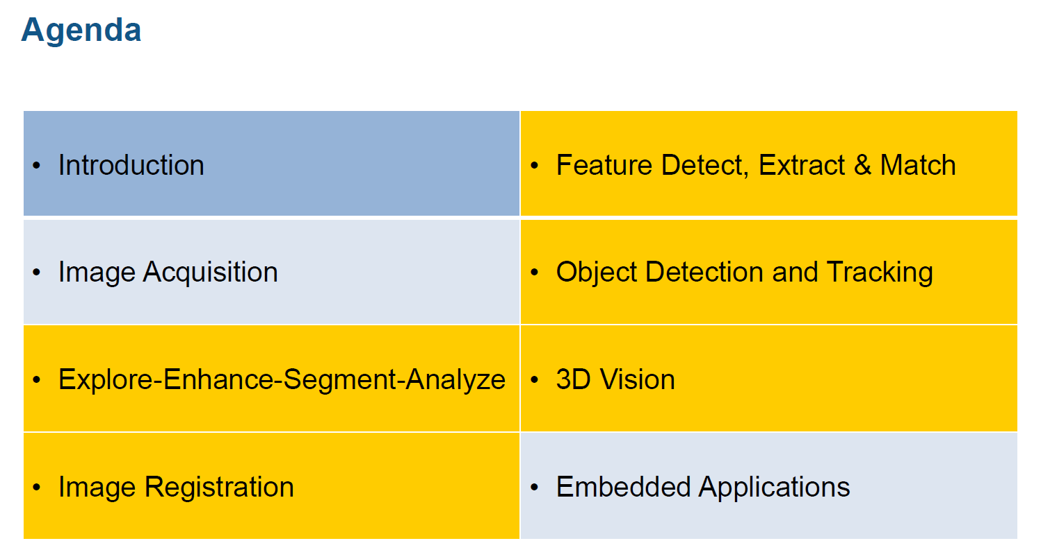

Slide 56
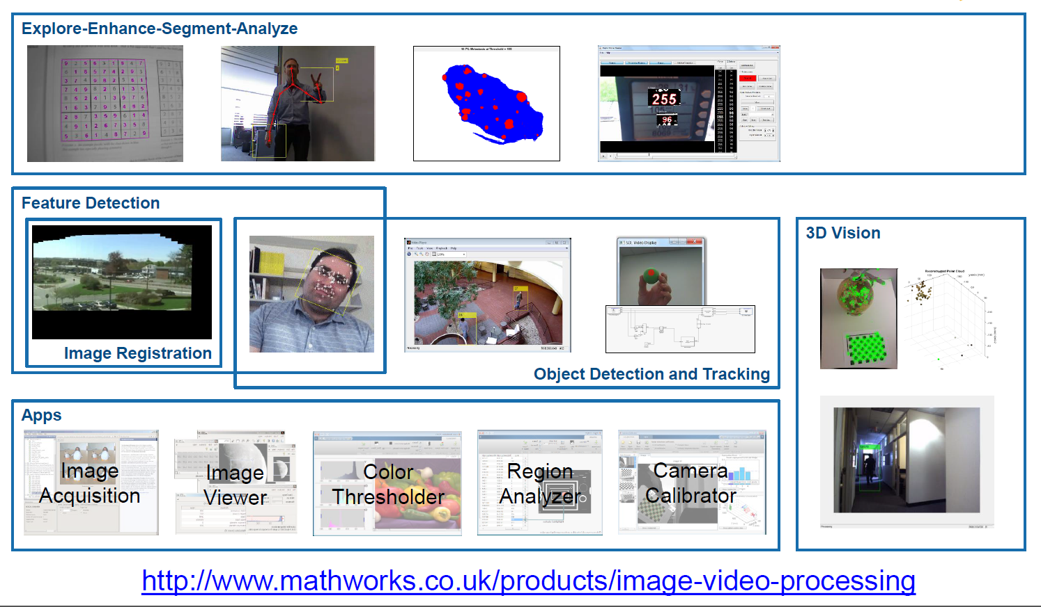

Slide 57
Source
Jinxiang Chai
S. Narasimhan
Dr. Jasmina Lazic
Development of project exercises and new MATLAB toolbox
RWTH – Mindstorms NXT Toolbox for MATLAB

